Slide 1






WELCOME TO CLASS 6C

Slide 2





Who's a milionaire?
1.Which grade are you in?
50:50
A. I am in 6 grade
B. I am in grade 6
B. I am in grade 6
C. I is in grade 6
D. I am on grade 6

Slide 3
Who's a milionaire?
2.Which class are you in ?
50:50
A. I am in class 6C
A. I am in class 6C
B. I am on class 6C
C. I is in class 6C
D. I am in 6C class

Slide 4
Who's a milionaire?
3.How many floors does your school have ?
50:50
A. It have two floors
B. It has two floor
C. It has two floors
C. It has two floors
D. It has floors

Slide 5
Who's a milionaire?
4.Where is your classroom?
50:50
A. It is in the second floor
B. It is on the second floor
B. It is on the second floor
C. It is on the two floor
D. It is on the second floors
Notes:
Kiếm câu để chuyển

Slide 6
Unit 4: Big or small ?
Period 23
Section C: Getting ready for school ( 1,2,3)

Slide 7

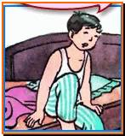
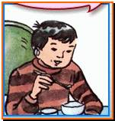
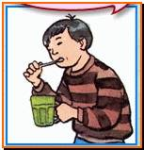
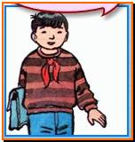
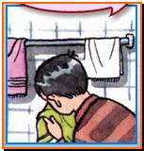
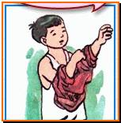
Unit 4: C1-2-3/ p.49
I. Vocabulary:
- get up (v) :
thức dậy
- get dressed (v) :
mặc quần áo
- brush teeth(v) :
đánh răng
- wash face (v) :
rửa mặt
- have breakfast(v) :
ăn sáng
- go to school (v) :
đến trường
- every (adj) :
mỗi/mọi

Slide 8
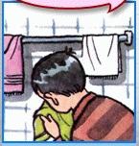
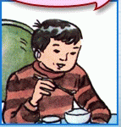
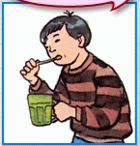
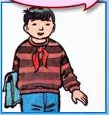
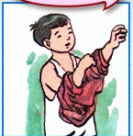
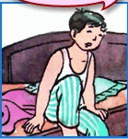
2. Matching
A
B
1. get up
2. get dressed
3. brush his teeth
4. wash his face
5. have breakfast
6. go to school
D
F
C
E

Slide 9
2. Matching
A
B
1. get up
2. get dressed
3. brush his teeth
4. wash his face
5. have breakfast
6. go to school
D
F
C
E

Slide 10
2.Model sentences:
1. What do you do every morning ?
get up
brush my teeth
I
have breakfast
go to school
2. What does Ba do every morning ?
gets up
brushes his teeth
He
has breakfast
goes to school

Slide 11

Grammar structure:
Note: Cách chia động từ ở thì hiện tại đơn :
- I/We/You/They + V ( nguyên mẫu)
- She/He/It + V(s, es)
Cách chia động từ ở ngôi thứ 3 số ít: He, She, It
- Khi động từ kết thúc là O, SH, CH, S, SS, X,Z + ES
- Khi động từ kết thúc là Y, đổi Y thành I + ES
- Còn lại hầu hết thêm S
  - Động từ TO HAVE chia đặc biệt: She /He/ It + has

Slide 12


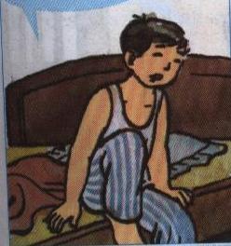
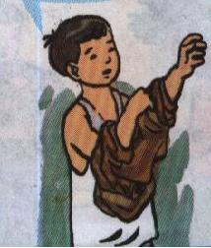
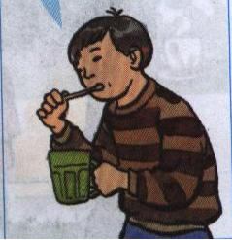
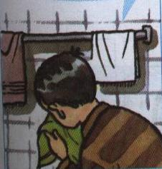
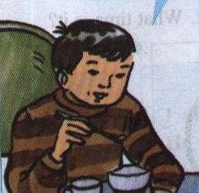
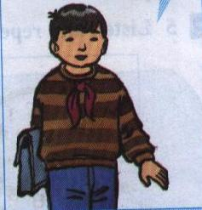
II: Practice:
I. Listen and repeat.
I get up.
I get dressed.
I brush my teeth.
Ba gets up.
He gets dressed.
He brushes his teeth.
I have breakfast.
I go to school.
I wash my face.
He washes his face.
He has breakfast.
He goes to school.

Slide 13
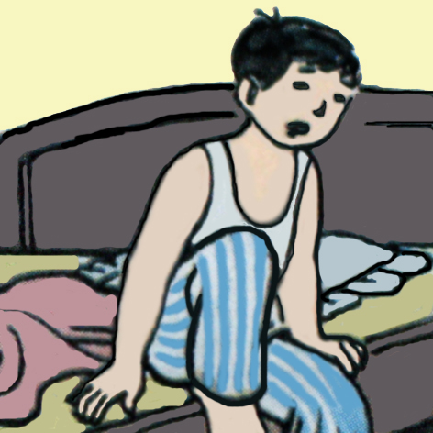
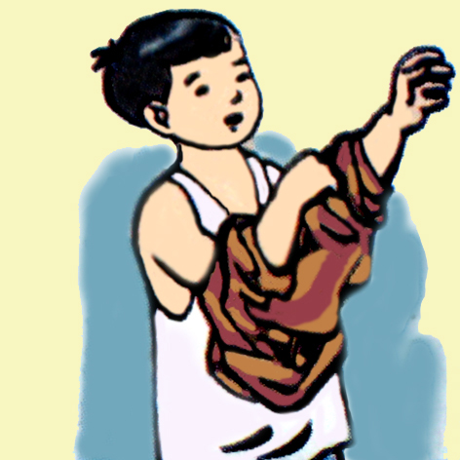
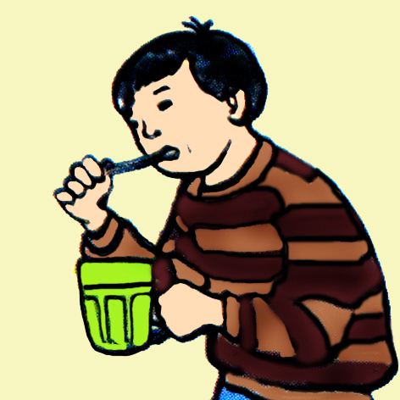
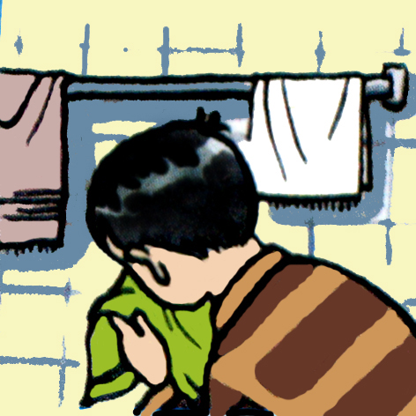
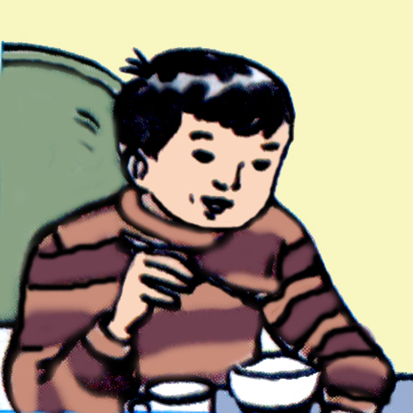
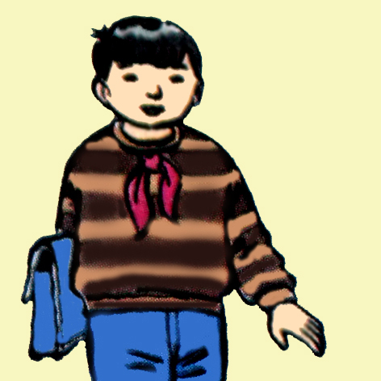
Preriod 24: Unit4. Big or small ?
Preriod 24: Unit4. Big or small ?
Monday October 06 ^{th} , 2012
Lesson 5: C : Getting ready for school (1,2,3)
I get up.
I get dressed.
I brush my teeth.
Ba gets up.
He gets dressed.
He brushes his teeth
I wash my face
I have breakfast
I go to school
He washes his face
He has breakfast
He goes to school

Slide 14
A: What do you do every morning?
Preriod 24: Unit4. Big or small ?
Lesson 5: C : Getting ready for school (1,2,3)
II. Practice
Example 1
B: I get up
I get up
I get dressed
I brush my teeth
I wash my face
I have breakfast
I go to school

Slide 15
A: What do you do every morning?
Preriod 24: Unit4. Big or small ?
Lesson 5: C : Getting ready for school (1,2,3)
II. Practice
Example 2
B: I get up. Then I……………
I get up
I get dressed
I brush my teeth
I wash my face
I have breakfast
I go to school

Slide 16
What does Ba do every morning ?
He
I
es
his
He
brush teeth.
He
my
get up.
I
s
get dressed.
I
s
his
to school.
He
He
I
wash face.
I
es
my
breakfast.
I
He
goes
have
go
has

Slide 17
Unit 4: C1-2/ p.49
III.Write
Write five sentences about Ba, begin with:
Every morning, Ba gets up. He …………..
Ba gets up.
He gets dressed.
He brushes his teeth.
He washes my face
He has breakfast
He goes to school

Slide 18
Unit 4: C1-2/ p.49
III.Write
Write five sentences about Ba, begin with:
Every morning, Ba gets up.
He …………..
Ba gets up.
He gets dressed
He brushes his teeth.
He gets dressed.
He brushes his teeth.
He washes he face
He goes to school.
He washes his face.
He has breakfast.
He goes to school
He has breakfast
Notes:
Nếu ướt bấm dấu tam giác sang trang bài tập. Cháy bấm trang 17

Slide 19



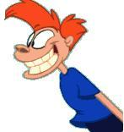
Multiple choice:
1. Ba and Lan up.
A. gets
B. get
D. has.
00
5
4
3
2
0
5
4
1
0
1
0
1
C. have.
3
2
5
4
3
1
2
2. He to school.
Start
End
A. go
B. has
C. goes
D. have
3. She brushes her .
A. breakfast
B. face
D. teeth
C. tooth
4. What he do every morning?
A. does
B. do
C. A & B are correct.
D. A & B are not correct.

Slide 20
Multiple choice:
1. Ba and Lan up.
A. gets
B. get
D. has.
00
5
4
3
2
0
5
4
1
0
1
0
1
C. have.
3
2
5
4
3
1
2
2. He to school.
Start
End
A. go
B. has
C. goes
D. have
3. She brushes her .
A. breakfast
B. face
D. teeth
C. tooth
4. What he do every morning?
A. does
B. do
C. A & B are correct.
D. A & B are not correct.

Slide 21
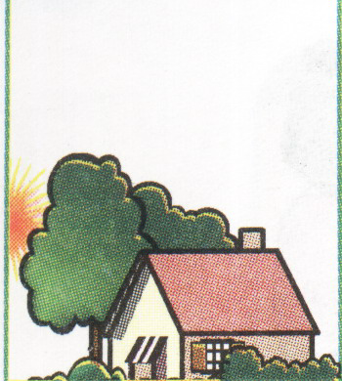
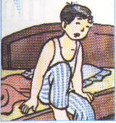
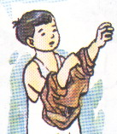
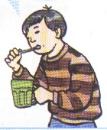
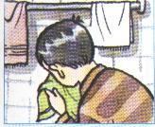
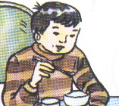
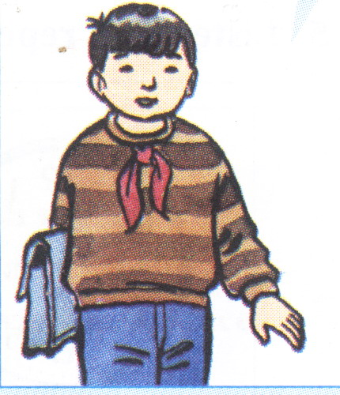
Using the information from the grids and write.
( Picture cues given )
This is Ba. He is a student . He is in class 6C.
He is in grade 6. Every
morning
, He
gets up
.
1
2
. He
.
He
gets dressed
. He
brushes his teeth
washes his face
3
4
5
He
has breakfast
. He
goes to school
.
6
7

Slide 22

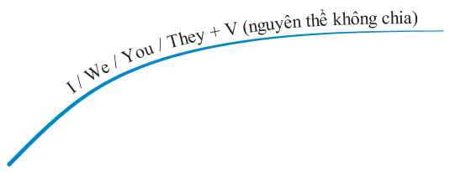


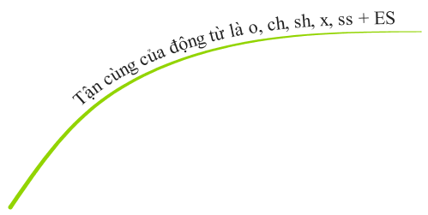
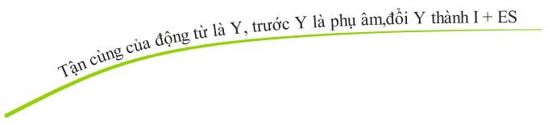



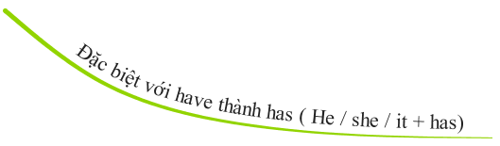






Slide 23
6. HOMEWORK
- Learn the new words.
- Write some sentences about what you do every morning (5 sentences) in your notebooks.
- Prepare : C4, C5, C6, C7.

Slide 24



Goodbye
See you again

Slide 25
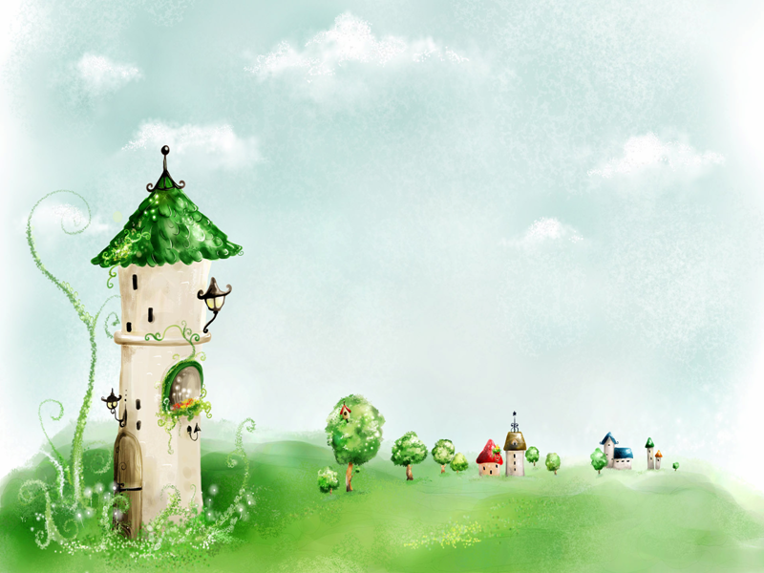
Thank you for your attention!

